Slide 1
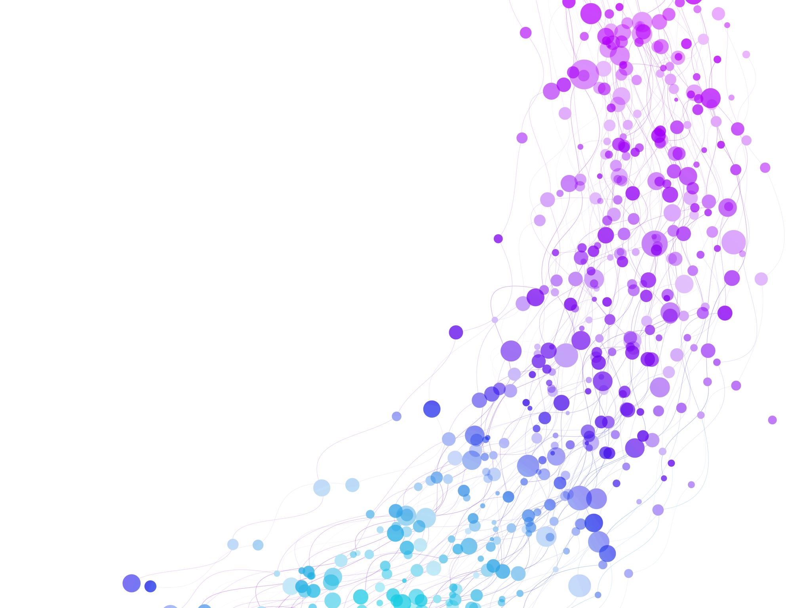


Semantic Analysis Lecture No.: 14 Course Name: Natural Language Processing Course Code: R1UC616C Instructor Name: Mr. Amit Yadav

Slide 2
At the end of this session students will be able to
.
Define semantic analysis and explain its role in natural language processing (NLP).
.
Evaluate the challenges of semantic analysis, including ambiguity, context dependency, and cultural variations

Slide 3
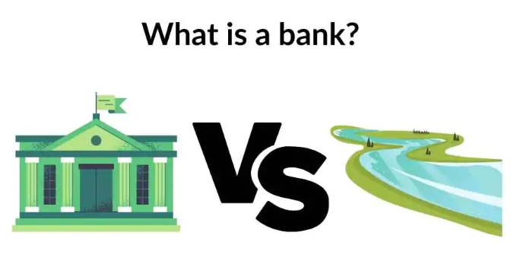
Introduction to Semantic Analysis
Semantic Analysis is a subfield of Natural Language Processing (NLP) that attempts to understand the meaning of Natural Language. Understanding Natural Language might seem a straightforward process to us as humans. However, due to the vast complexity and subjectivity involved in human language, interpreting it is quite a complicated task for machines. Semantic Analysis of Natural Language captures the meaning of the given text while taking into account context, logical structuring of sentences and grammar roles

Slide 4

Activity 1 (Think pair share)
Scenario: You type "Apple stock price" into Google. What does "Apple" mean?
How does Google know if you mean Apple the company or apple the fruit?
What if someone searches "Apple tree care tips"—how does AI differentiate?

Slide 5
Parts of Semantic Analysis
Lexical Semantic Analysis: Lexical Semantic Analysis involves understanding the meaning of each word of the text individually.
2. Compositional Semantics Analysis: Analyzes the meaning of entire sentences, considering how words combine to convey a complete thought.
For example, consider the following two sentences:
Sentence 1: Students love Galgotia University.
Sentence 2: Galgotia University love Students

Slide 6

Resource Document: https://drive.google.com/drive/folders/1ksqYfW2x_av3Q7lhZHB8PqGv4Q48sw0e

Slide 7

Learning Activity 1
Instruction:
First, write your group number in each technique section, then write your answer.
Hyponymy
Hypernymy
Homonymy
Synonymy
Antonymy
Polysemy

Slide 8
Elements of Semantic Analysis
Hyponymy
Hypernymy
Homonymy
Synonymy
Antonymy
Polysemy
Meronomy

Slide 9
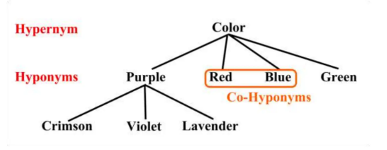
Elements of Semantic Analysis
Hyponymy and Hypernymy
Hyponymys refers to a term that is an instance of a generic term. They can be understood by taking class-object as an analogy. For example: ‘Color‘ is a hypernymy while ‘purple‘, ‘blue‘, ‘red‘, etc, are its hyponyms.

Slide 10
….Cont….
Homonymy: Homonymy refers to two or more lexical terms with the same spellings but completely distinct in meaning. For example: ‘Rose‘ might mean ‘the past form of rise‘ or ‘a flower‘, – same spelling but different meanings; hence, ‘rose‘ is a homonymy.
Synonymy: When two or more lexical terms that might be spelt distinctly have the same or similar meaning, they are called Synonymy. For example: (Job, Occupation), (Large, Big), (Stop, Halt).
Antonymy: Antonymy refers to a pair of lexical terms that have contrasting meanings – they are symmetric to a semantic axis. For example: (Day, Night), (Hot, Cold), (Large, Small).

Slide 11
….Cont….
Polysemy: Polysemy refers to lexical terms that have the same spelling but multiple closely related meanings. It differs from homonymy because the meanings of the terms need not be closely related in the case of homonymy. For example: ‘man‘ may mean ‘the human species‘ or ‘a male human‘ or ‘an adult male human‘ – since all these different meanings bear a close association, the lexical term ‘man‘ is a polysemy.
Meronomy: Meronomy refers to a relationship wherein one lexical term is a constituent of some larger entity. For example: ‘Wheel‘ is a meronym of ‘Automobile‘

Slide 12
Application of Semantic Analysis in NLP
1. Search Engines (Google, Bing):
Helps understand user intent
2. Chatbots & Virtual Assistants (Alexa, Siri, Google Assistant):
Enables bots to understand natural conversations and provide
accurate responses.
3. Sentiment Analysis (Product Reviews, Social Media Monitoring):
Companies use it to analyze customer opinions on products

Slide 13
Challenges in Semantic Analysis
1. Ambiguity:
Words and phrases can have multiple meanings.
Example: "Bank" (financial institution vs. riverbank).
2. Context Dependency:
Meaning often relies on surrounding text or real-world knowledge.
Example: "He broke the ice" could mean literally or figuratively.
3. Cultural and Linguistic Variations:
Different languages and cultures express meaning differently.
Example: Idioms and metaphors vary across languages.
4.Complexity of Human Language:
Sarcasm, irony, and figurative language are difficult to interpret.
Example: "Great, another traffic jam!" (sarcasm).

Slide 14
Information to next topic of the course
Next Lecture: Word Sense Disambiguation
https://www.geeksforgeeks.org/word-sense-disambiguation-in-natural-language-processing/

Slide 15

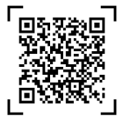
Review and Reflection from students

